Slide 1
Dataset
Added: Tuesday, 11/22/2017
Ocean Carbon States Analysis

Slide 2
Observations Source (12-month, 4º x 5º resolution)
Added: Tuesday, 11/22/2017
Air-sea flux: from Carbon Dioxide Information Analysis Center (LDEO 5 database (NDP-088); Takahashi et al., 2009). It is derived from the difference between surface water pCO2 (pCO2SW), air pCO2, and the air-sea gas transfer rate.
Surface water pCO2: mean distribution from 3 million measurements from 1970 to 2007, and normalized to a reference year 2000 (Takahashi et al., 2009).
The pCO2 of the air: from the GlobalView CO2 concentration zonal mean, NCAR monthly mean barometric pressure, SST, and salinity (Takahashi et al., 2009).
Wind speed: from the 1979-2005 climatological mean NCEP-DOE 10 AMIP-II Reanalysis wind speed field (Takahashi et al., 2009).
Sea surface temperature: from NOAA Climate Diagnostic Center Objective Interpolation (Takahashi et al., 2009).
Nitrate at 1 degree horizontal resolution is obtained from the World Ocean Atlas 2013 version 215 (Boyer et al., 2013).

Slide 3
Contour Plots
Sunday, 10/22/2017
Ocean Carbon States Analysis

Slide 4
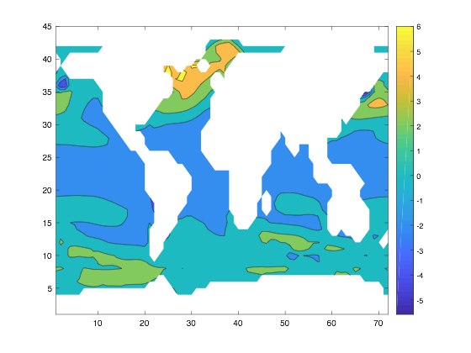
Understanding air-sea flux of CO2 using contour plot
Sunday, 10/22/2017
Plot uses 12-month climatology data.
Plot on the left shows higher concentration of CO2 going into the ocean on the northern part of the earth (ie. North Atlantic), as indicated by lighter orange color.
Continents are shown in white since climate data is specific to ocean carbon observational and model data.
How about other variables? Let’s compare between model and observations
Figure 1: Air-Sea Flux 2-D Contour Plot
Notes:
>> contourf(nanmean(MOD_FLUX,3))

Slide 5
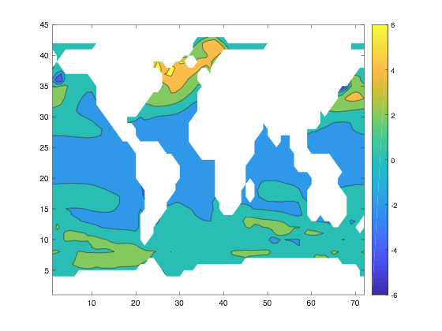
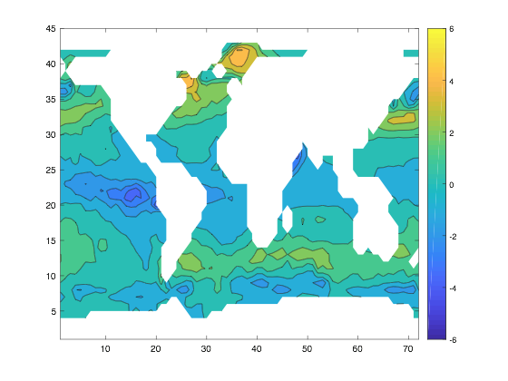
Var 1: Air-sea flux of CO2 (FLUX)
Sunday, 10/22/2017
Model
Observation
Figure 2: Air-sea flux contour plot comparison between model and observation:
More air-sea flux differences in observational data compared to model.
Notes:
>> contourf(nanmean(MOD_FLUX,3))

Slide 6
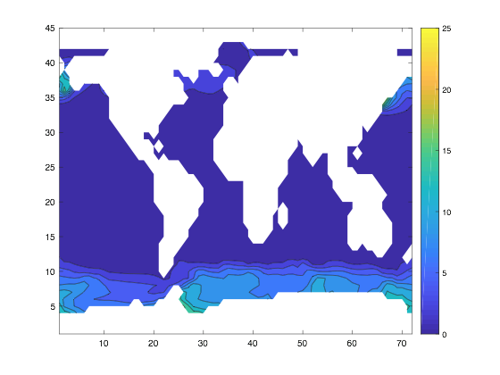
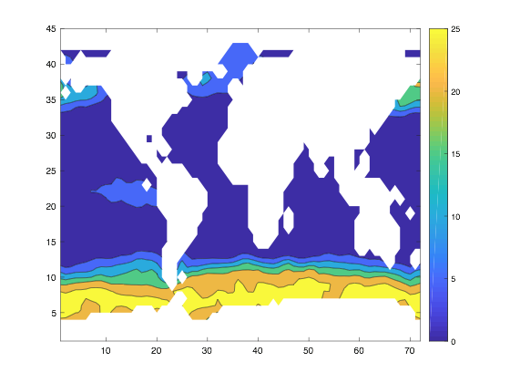
Var 2: Nitrate in the sea water (NITR)
Sunday, 10/22/2017
Model
Observation
Figure 3: Nitrogen level contour plot comparison between model and observation
Notes:
>> contourf(nanmean(MOD_FLUX,3))

Slide 7
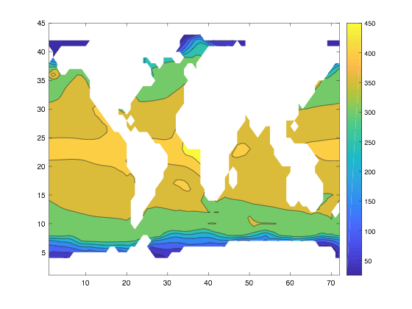
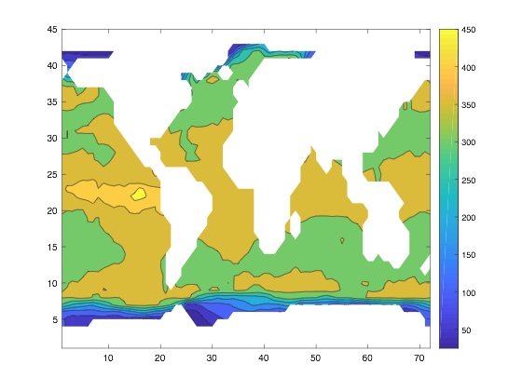
Var 3: Partial pressure of CO2 in surface water (pCO2)
Sunday, 10/22/2017
Model
Observation(??)
Figure 4: Partial pressure of CO2 contour plot comparison between model and observation

Slide 8
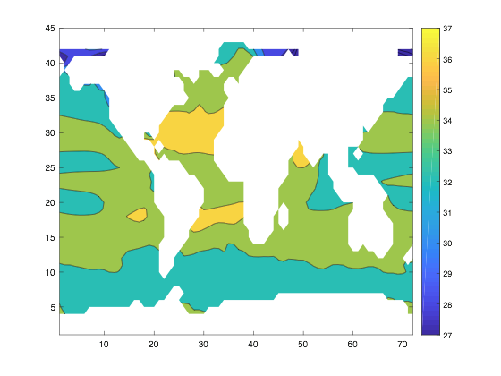
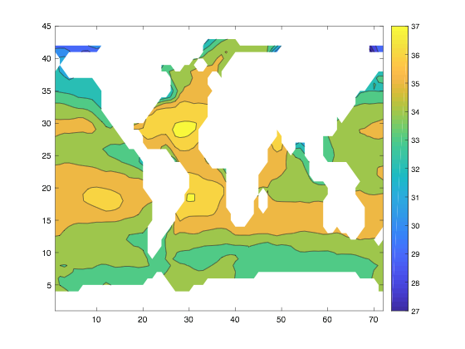
Var 4: Salinity of the sea water (SAL)
Sunday, 10/22/2017
Model
Observation
Figure 5: Salinity contour plot comparison between model and observation

Slide 9
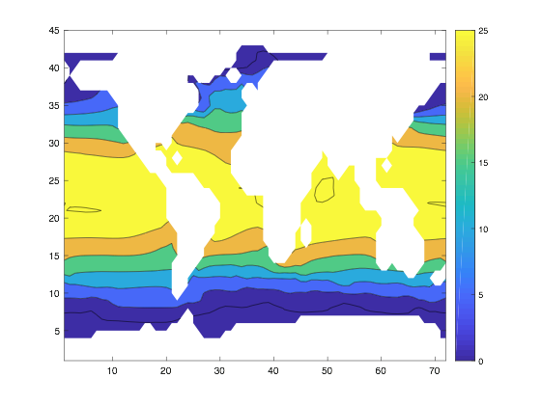
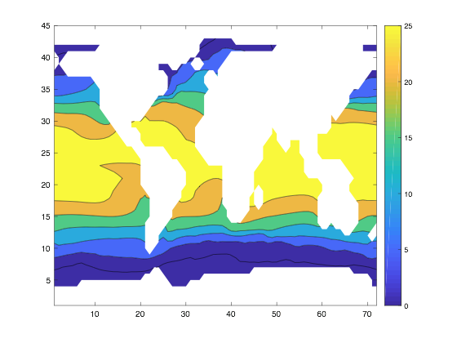
Var 5: Sea Surface Temperature (SST)
Sunday, 10/22/2017
Model
Observation
Figure 6: Ocean temperature contour plot comparison between model and observation

Slide 10
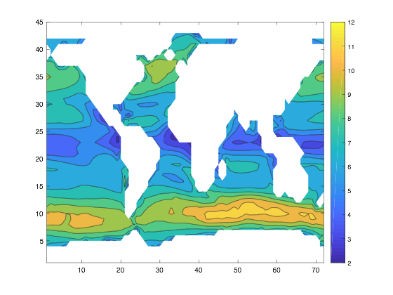
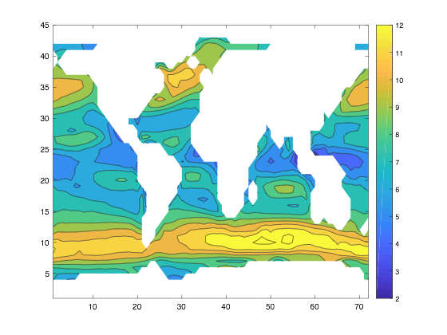
Var 6: Wind speed at the surface of the ocean (WSPD)
Sunday, 10/22/2017
Model
Observation
Figure 7: Wind speed contour plot comparison between model and observation

Slide 11
Contour Plot Analysis: Model v. Observation
Tuesday, 11/07/2017
Based on the density observation on contour plots, we can compare the variables performance between model and observation data:
Variables that correspond fairly well | Variables that do not correspond as well
Air-sea flux | Nitrogen level
Partial pressures of CO2 | Salinity (a little higher in OBS)
Sea surface temperature
Wind speed

Slide 12
Contour Plot Analysis: Model v. Observation
Tuesday, 11/07/2017
Observations contour plots are generally more granular while the models contour plots are broader in range.
According to the above analysis, by looking at comparison on geographical distribution of variables in models and observation data, a possible feature to include in the clustering technique would be wind speed.
From both PDD and contour plot, wind speed distributions between model simulation and observational data behave similarly as SST. Thus we are adding the WSPD variable to the analysis.

